Slide 1
Perceptual Organization
LiMN Lab

Slide 2
Goal
The hypothesis focuses on the interaction between attention and memory encoding strategies.
Some auditory features, such as pitch, are hypothesized to be more easily remembered when arranged in sequences.
Some auditory features, such as syllables or everyday sounds, are hypothesized to be more effectively remembered as individual items.

Slide 3
Auditory Object Formation
Onset timing: The brain often groups sounds that start at the same time into a single auditory object.
Temporal Variation
Temporal coherence: Sounds that have the same pattern of changes over time (even if they are different pitches) can be grouped as a single auditory object.
Spectral content: The frequencies that make up a sound can help our brains distinguish between different sound sources. For instance, a violin and a flute playing the same note can be distinguished based on their different spectral contents (or timbre).
Spatial location: Our brains use information from both ears to localize sounds in space, which helps separate different sound sources.
Continuity and prior experience: Our brains expect sound sources to continue over time and space, and use past experience with familiar sounds to inform auditory object formation.

Slide 4
Original Study
The original study used two types of auditory stimuli: pure tones (pitches) and complex everyday sounds.
Participants were asked to listen to a sequence of these sounds, followed by a pause and then a single sound.
In the present/absent task, participants had to determine whether the single sound after the pause was present or absent in the previous sequence.
In the same/different task, participants listened to a sequence of sounds, a pause, and then another sequence of sounds. They had to determine whether the second sequence was the same as or different from the first one.
Findings indicated that participants performed better at identifying pitches in the same/different task and performed better at identifying everyday sounds in the present/absent task.

Slide 5
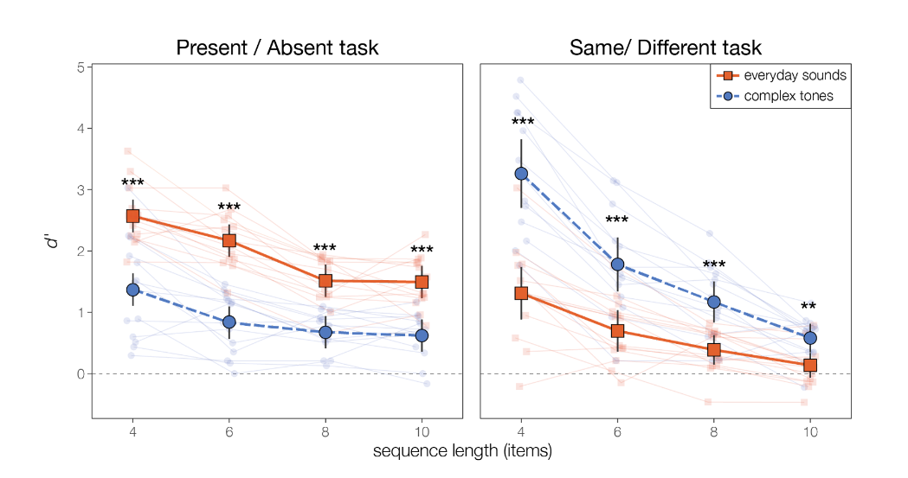
The Original Study result

Slide 6
Concerns
Concern over stimulus complexity differences.
Potential overshadowing of attention's effect.
Recommendation for similar complexity stimuli or adjusted control conditions.

Slide 7
Present & Absent Task
Attend: Pitch
Attend: Syllable
Same & different Task
Attend: Pitch
Attend: Syllable

Slide 8
Present & Absent Task Graph Demo (attend syllable)
BAH
GAH
BOO
DEE
GEE
1st Sequence
BOO
Present
OR
Absent
BEE
Notes:
Let me introduce the tasks, P/A and S/D tasks. In PA, you will be present a sequence of syllables and pitch pair, then a single syllable pitch pair. Your tasks is to attend whether the pitch or syllable is present or absent in the 1st seq.

Slide 9

Present & Absent Task Audio Demo (attend syllable)
Notes:
This demo you are asked to attend syllable. di bu ge bi da gu -du
absent

Slide 10
Same & Different Task Graph Demo (Attend Pitch)
BAH
BAH
BAH
BAH
BAH
Da
Ba
Gee
Ga
Bee
1st Sequence
BAH
BAH
BAH
BAH
BAH
Ba
Da
Ga
Dee
Gee
SAME
OR
BAH
BAH
BAH
BAH
BAH
Ba
Da
Ga
Dee
Gee
DIFFERENT
Notes:
In SD, you will be present a sequence of syllables and pitch pair, then another sequence syllable pitch pair. Your tasks is to attend whether the pitch or syllable is S or D in the 1st seq. This demo you are asked to attend Pitch.

Slide 11
Same & Different Task Audio Demo (Attend Pitch)
Notes:
This demo you are asked to attend pitch. Pay attention to the beginning of the sequence 1st and 2nd pitches are swapped
different

Slide 12
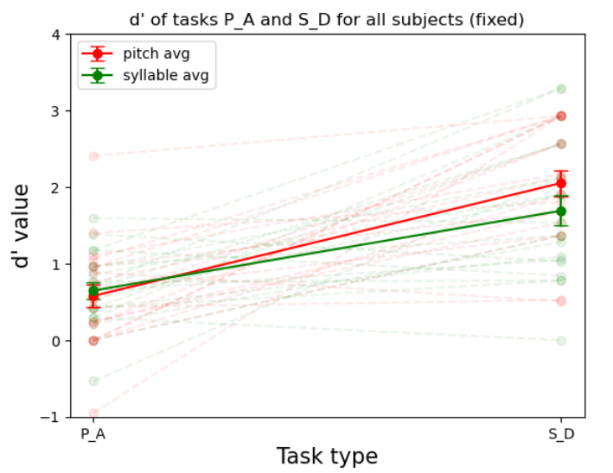
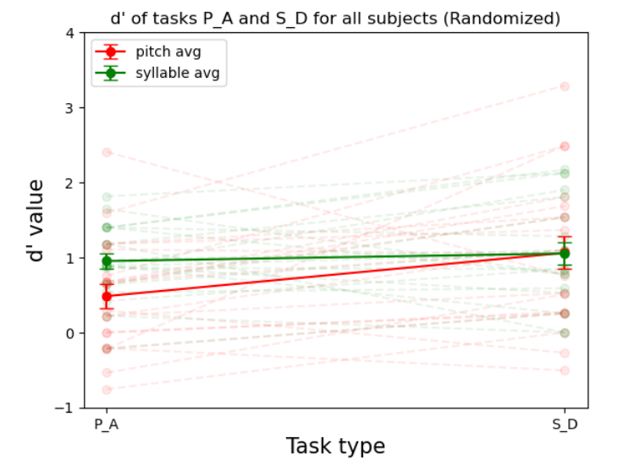
Result with length 6 fixed or randomized condition
Notes:
20 trials per condition

Slide 13
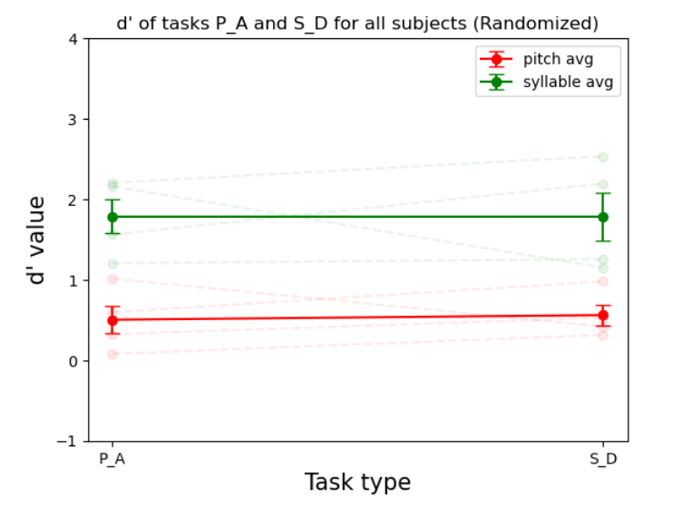
Result with Len-4 randomized task (4 subjects)
Masking
Mislead the pitch perception
Randomized syllable stronger masking than pitch
Linguistic load:
Syllable might be linguistic processing
Everyday sound might be sound object processing (non-linguistic)
Sound complexity
Syllable - energy across harmonic
Everyday sound - broadband energy distribution
Notes:
Another the part is that the fundamental frequence for my stimuli is 200 which is nothing at all. Compare to the musical notes

Slide 14
3 possible ideas
Convert the syllable's varied pitch to a musical frequency
Current 200 hz non musical
Ex: C (256 hz)
Promote streaming & pitch recognition
Everyday sound with pitch variation
Harder to repeat
Less linguistic and masking
Choose another feature
Ex: intensity vs pitch
Threshold per people

Slide 15
Transforming Varied Pitch Syllables into Musical Frequencies
First Attempt: 2 Semitones Apart
Setup: Keeping a similar range (C4 to D5) for both genders.
Result:
Sounds slightly musical (streaming)
Little changed compared to non-musical frequency
Second Attempt: 3 Semitones Apart
Setup:
Choose frequencies according to the vocal characteristics of each gender
Results:
Found little difference in the perception of gender from the first attempt.
Notes:
1st: Discuss concerns regarding the range: Male vocals (C3 to D4) and female vocals (F3 to C6).
Highlight issues: D5 too high for males, C3 acceptable for females, optimal range found to be C4 to D5.
2nd: (C2 to C4 for males, with a median of C3; C3 to C5 for females, with a median of C4).

Slide 16
Everyday sound with pitch variation
The original frequency can approximate to a musical note, but variations within the syllable can mislead the perception of pitch.
The pitch variation cannot be included in the everyday sound
Broadband energy distribution -> no f0 (unlike vocal)
Only applicable to some oscillation based sound
Obvious sound distortion

Slide 17
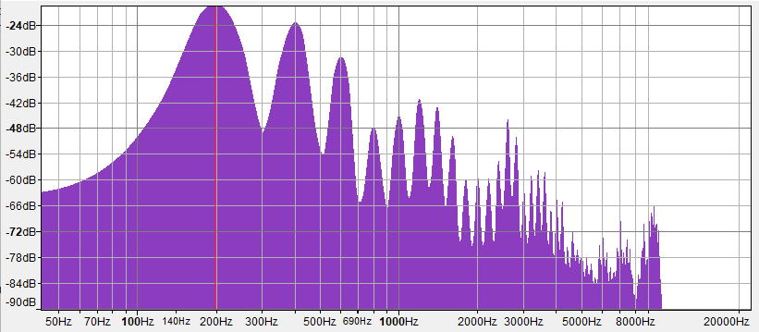
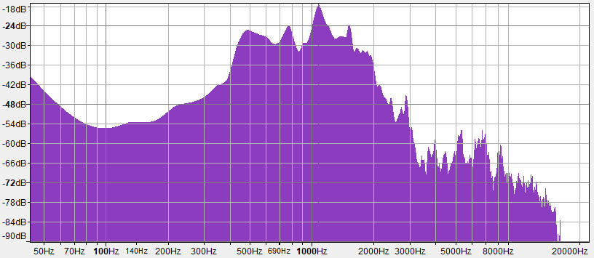
Syllable vs Everyday sound Spectrum
Syllable： Boo at 200hz Everyday Sound: Dog Bark

Slide 18
Pitch with different instruments
Use different instruments to play musical notes
Identify the instruments (timbre) vs pitch
Advantage
Pitch variation is natural
Essentially listen to complex note, the timbre has little effect on the pitch (no masking)
Instruments are individual objects
Core: pitch vs timbre
Pitch: frequency difference
Timbre:
Temporal difference ADSR: attack, decay, sustain and release (energy distribution) (Fundamentals of Music Processing)
Harmonic difference: different combinations of fundamental frequencies and overtones (or harmonics)
Spectral shape: the distribution of energy across different frequencies at any given moment.

Slide 19
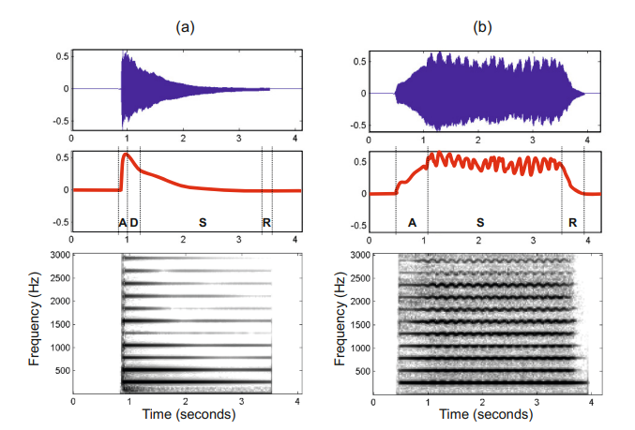
Different instrument playing C
Piano
violin
Figure 1.23 from [Muller, FMP, Springer 2015]
Notes:
https://www.audiolabs-erlangen.de/resources/MIR/FMP/C1/C1S3_Timbre.html

Slide 20
Plan

Slide 21
Purpose
How is perceptual organization shapes working memory, such that features of a single auditory object are stored together (streaming).

Slide 22
Same/Different vs. Present/Absent Tasks
Same/Different
Probes how well items are recalled as a sequence (1 ‘auditory object’)
Present/Absent
Probes how well items are recalled individually (multiple ‘auditory objects’)

Slide 23






Fixed vs. Randomized non-attending dimension
Streaming ↑
Steaming ↓

Slide 24
What do we expect
Attending syllable is easier in P/A than S/D tasks
Attending pitch is easier in S/D than P/A tasks

Slide 25
Single talker vs. Multiple talker
Only syllables changing
streaming ↑
Syllables + talker changing
streaming ↓

Slide 26
Same & Different Task (Attend Pitch): Fixed non-attending dimension (Syllable)
BAH
BAH
BAH
BAH
BAH
DAH
DAH
DAH
DAH
DAH
1st Sequence
.
.
.
BAH
BAH
BAH
BAH
BAH
DAH
DAH
DAH
DAH
DAH
SAME
OR
BAH
BAH
DAH
DAH
DAH
BAH
BAH
DAH
DAH
BAH
DIFFERENT

Slide 27
Same & Different Task (Attend Pitch): Randomized non-attending dimension (Syllable)
BAH
GAH
BOO
DEE
GEE
1st Sequence
.
.
.
BAH
GAH
BOO
DEE
GEE
SAME
DOO
DEE
BAH
GAH
BEE
OR
BAH
GAH
DEE
GEE
DOO
DEE
BAH
GAH
BOO
BEE
DIFFERENT

Slide 28
Same & Different Task (Attend Syllable): Fixed non-attending dimension (Pitch)
BAH
GAH
BOO
DEE
GEE
1st Sequence
.
.
.
BAH
GAH
BOO
DEE
GEE
SAME
OR
BAH
GAH
DEE
BOO
GEE
DIFFERENT

Slide 29
Same & Different Task (Attend Syllable): Randomized non-attending dimension (Pitch)
BAH
GAH
BOO
DEE
GEE
1st Sequence
.
.
.
BAH
GAH
BOO
DEE
GEE
SAME
OR
BAH
GAH
DEE
BOO
GEE
DIFFERENT

Slide 30
Present & Absent Task (Attend Pitch): Fixed non-attending dimension (Syllable)
BAH
BAH
BAH
BAH
BAH
DAH
DAH
DAH
DAH
DAH
1st Sequence
.
.
.
BAH
DAH
Present
OR
DAH
BAH
Absent

Slide 31
Present & Absent Task (Attend Pitch): Randomized non-attending dimension (Syllable)
BAH
GAH
BOO
DEE
GEE
1st Sequence
.
.
.
BAH
DAH
Present
OR
DAH
BAH
Absent

Slide 32
Present & Absent Task (Attend Syllable): Fixed non-attending dimension (Pitch)
BAH
GAH
BOO
DEE
GEE
1st Sequence
.
.
.
BOO
Present
OR
BEE
Absent

Slide 33
Present & Absent Task (Attend Pitch): Randomized non-attending dimension (Syllable)
BAH
GAH
BOO
DEE
GEE
1st Sequence
.
.
.
BOO
Present
OR
BEE
Absent

